Slide 1
A Real-time Classroom Attendance System Utilizing Viola-Jones for Face Detection and LBPH for Face Recognition
Participants:
Ashish Tiwari, 161709
Nischal Lal Shrestha, 161722
Saroj Bhattarai, 161732
Srijan Thapa, 161735
Under the supervision of:
Assoc. Prof. Saroj Shakya
January 10, 2020

Slide 2
Intro
Methodology
System Implementation
Conclusion and Future Work
Thank you. Questions?
Introduction
Problem Statement
Project Objectives
Introduction
Maintenance of attendance records play an important role in performance analysis
Various methods of attendance recording mechanism are utilized
In the classroom, the traditional way of marking attendance involves a human calling out the name of the students individually
An automated real-time classroom attendance system performs the daily activities of attendance marking with reduced human intervention
Ashish T., Nischal L.S., Saroj B. , Srijan T.
Real-time Classroom Attendance System 2/15

Slide 3
Intro
Methodology
System Implementation
Conclusion and Future Work
Thank you. Questions?
Introduction
Problem Statement
Project Objectives
Problem Statement
Contemporary attendance technique is subject to manipulation,
Chances of human error during record entry,
Waste of precious class time,
Requires human intervention,
Lacks the benefit of current innovations in data analysis.
Ashish T., Nischal L.S., Saroj B. , Srijan T.
Real-time Classroom Attendance System 3/15

Slide 4
Intro
Methodology
System Implementation
Conclusion and Future Work
Thank you. Questions?
Introduction
Problem Statement
Project Objectives
Project Objectives
Accurately match detected students faces to those on the database.
Develop an intuitive user interface for navigation of different functionalities.
Ashish T., Nischal L.S., Saroj B. , Srijan T.
Real-time Classroom Attendance System 4/15

Slide 5
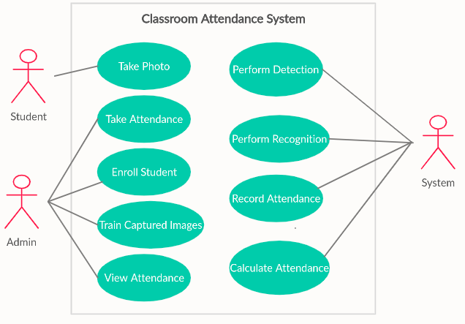
Intro
Methodology
System Implementation
Conclusion and Future Work
Thank you. Questions?
Use Case
Agile Software Development
Tools and Frameworks
Use case
Student
Admission Officer
System
Ashish T., Nischal L.S., Saroj B. , Srijan T.
Real-time Classroom Attendance System 5/15

Slide 6
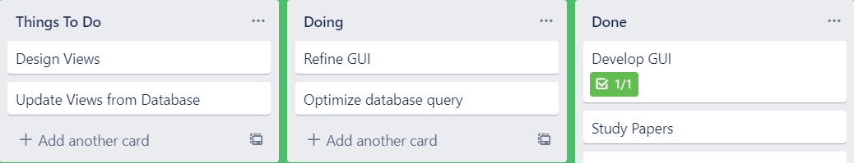
Intro
Methodology
System Implementation
Conclusion and Future Work
Thank you. Questions?
Use Case
Agile Software Development
Tools and Frameworks
Agile Software Development
Kanban framework of Agile Software Development
Trello is used for taking notes and posting updates
Kanban boards notify of what tasks are part of the project
Columns gives idea about the stage the task is at
Ashish T., Nischal L.S., Saroj B. , Srijan T.
Real-time Classroom Attendance System 6/15

Slide 7






Intro
Methodology
System Implementation
Conclusion and Future Work
Thank you. Questions?
Use Case
Agile Software Development
Tools and Frameworks
Tools and Frameworks
Ashish T., Nischal L.S., Saroj B. , Srijan T.
Real-time Classroom Attendance System 7/15

Slide 8
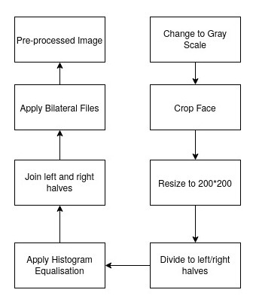
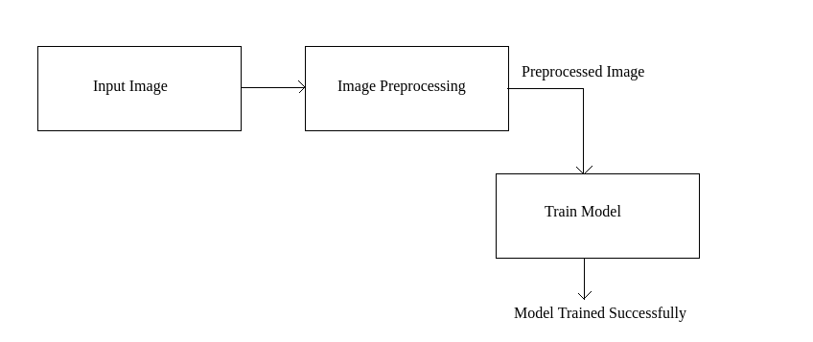
Intro
Methodology
System Implementation
Conclusion and Future Work
Thank you. Questions?
Image Acquisition
Face Detection and Preprocessing
Face Recognition
Database Integration
GUI Development
System Implementation
Ashish T., Nischal L.S., Saroj B. , Srijan T.
Real-time Classroom Attendance System 8/15

Slide 9
Intro
Methodology
System Implementation
Conclusion and Future Work
Thank you. Questions?
Image Acquisition
Face Detection and Preprocessing
Face Recognition
Database Integration
GUI Development
Image Acquisition
In order to train model, images of object has to be captured
For a single student, 100 images are taken
Each image is changed from RGB to Grayscale
The images acts as input to face detection
Ashish T., Nischal L.S., Saroj B. , Srijan T.
Real-time Classroom Attendance System 9/15

Slide 10
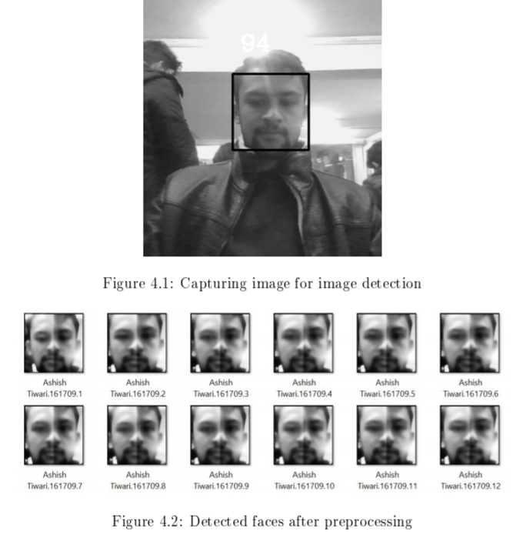
Intro
Methodology
System Implementation
Conclusion and Future Work
Thank you. Questions?
Image Acquisition
Face Detection and Preprocessing
Face Recognition
Database Integration
GUI Development
Face Detection and Preprocessing
Face detection is achieved through Haar feature-based cascade classifiers
OpenCV provides pretrained models
Necessary XML file is loaded and detection is done which returns boundary rectangles for the detected faces
The detected faces are preprocessed for recognition enhancement using:
Histogram Equalization
Bilateral Filter
Ashish T., Nischal L.S., Saroj B. , Srijan T.
Real-time Classroom Attendance System 10/15

Slide 11
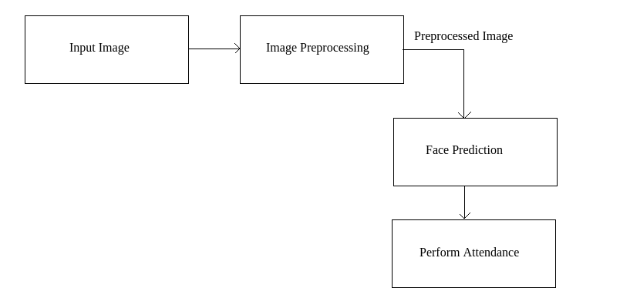
Intro
Methodology
System Implementation
Conclusion and Future Work
Thank you. Questions?
Image Acquisition
Face Detection and Preprocessing
Face Recognition
Database Integration
GUI Development
Face Recognition
The acquired image is feed into the trained model which returns "label” and "confidence“
Based on “label” and “confidence”, attendance is recorded.
Ashish T., Nischal L.S., Saroj B. , Srijan T.
Real-time Classroom Attendance System 11/15

Slide 12
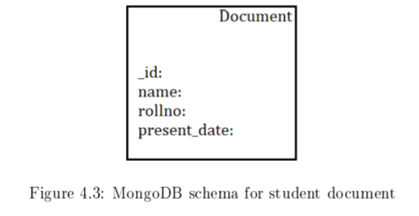
Intro
Methodology
System Implementation
Conclusion and Future Work
Thank you. Questions?
Image Acquisition
Face Detection and Preprocessing
Face Recognition
Database Integration
GUI Development
Database Integration
MongoDB stores the attendance record
Each time the face is recognized, his/her record is pushed to the database
The schema of database is shown below:
Ashish T., Nischal L.S., Saroj B. , Srijan T.
Real-time Classroom Attendance System 12/15

Slide 13
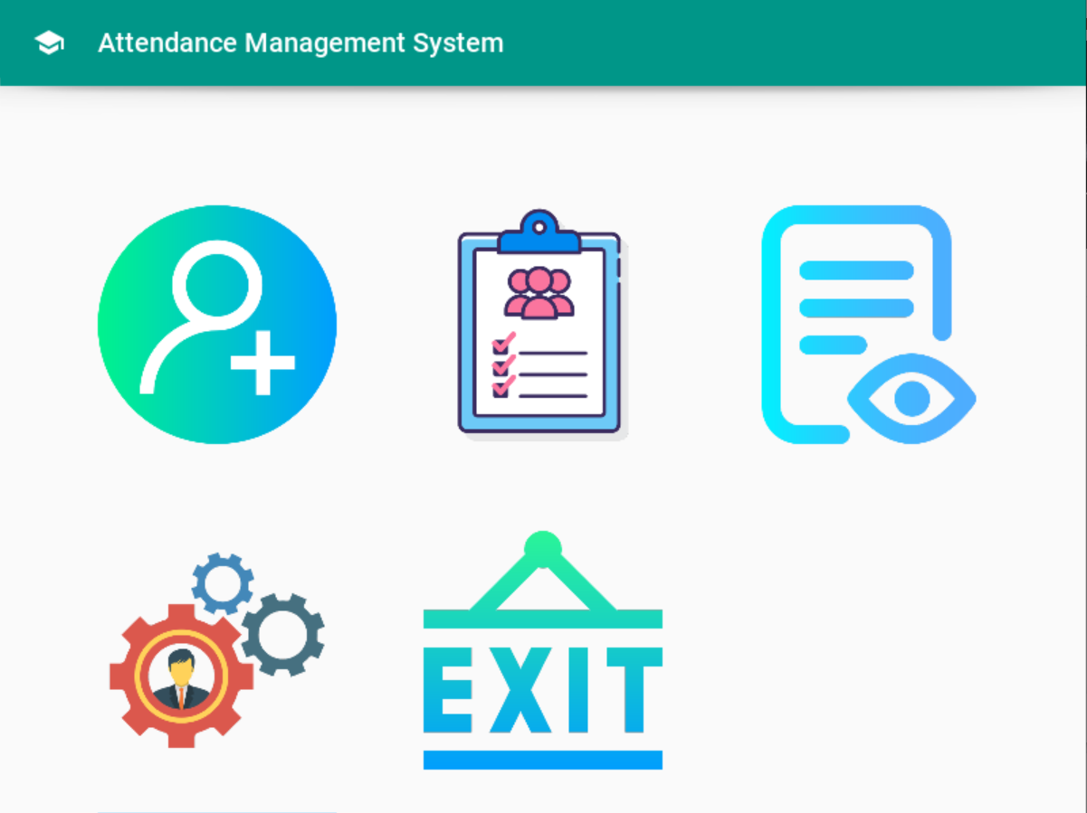
Intro
Methodology
System Implementation
Conclusion and Future Work
Thank you. Questions?
Image Acquisition
Face Detection and Preprocessing
Face Recognition
Database Integration
GUI Implementation
GUI Implementation
Kivymd an extension of Kivy for Python is used
Kivymd follows the Google’s Material Design Principle
Ashish T., Nischal L.S., Saroj B. , Srijan T.
Real-time Classroom Attendance System 13/15

Slide 14
Intro
Methodology
System Implementation
Conclusion and Future Work
Thank you. Questions?
Conclusion and Future Work
Conclusion and Future Work
The completion of the project resulted in a software product that is able to automate the classroom attendance
The GUI built on top of the system helps the users to easily navigate through records
Students behavior and their engagement in classroom at various lectures could be enhanced using artificial intelligence
Ashish T., Nischal L.S., Saroj B. , Srijan T.
Real-time Classroom Attendance System 14/15

Slide 15
Intro
Methodology
System Implementation
Conclusion and Future Work
Thank you. Questions?
Thank you. Questions?
Thank you for your attention!
Questions?
Ashish T., Nischal L.S., Saroj B. , Srijan T.
Real-time Classroom Attendance System 15/15

